Slide 1

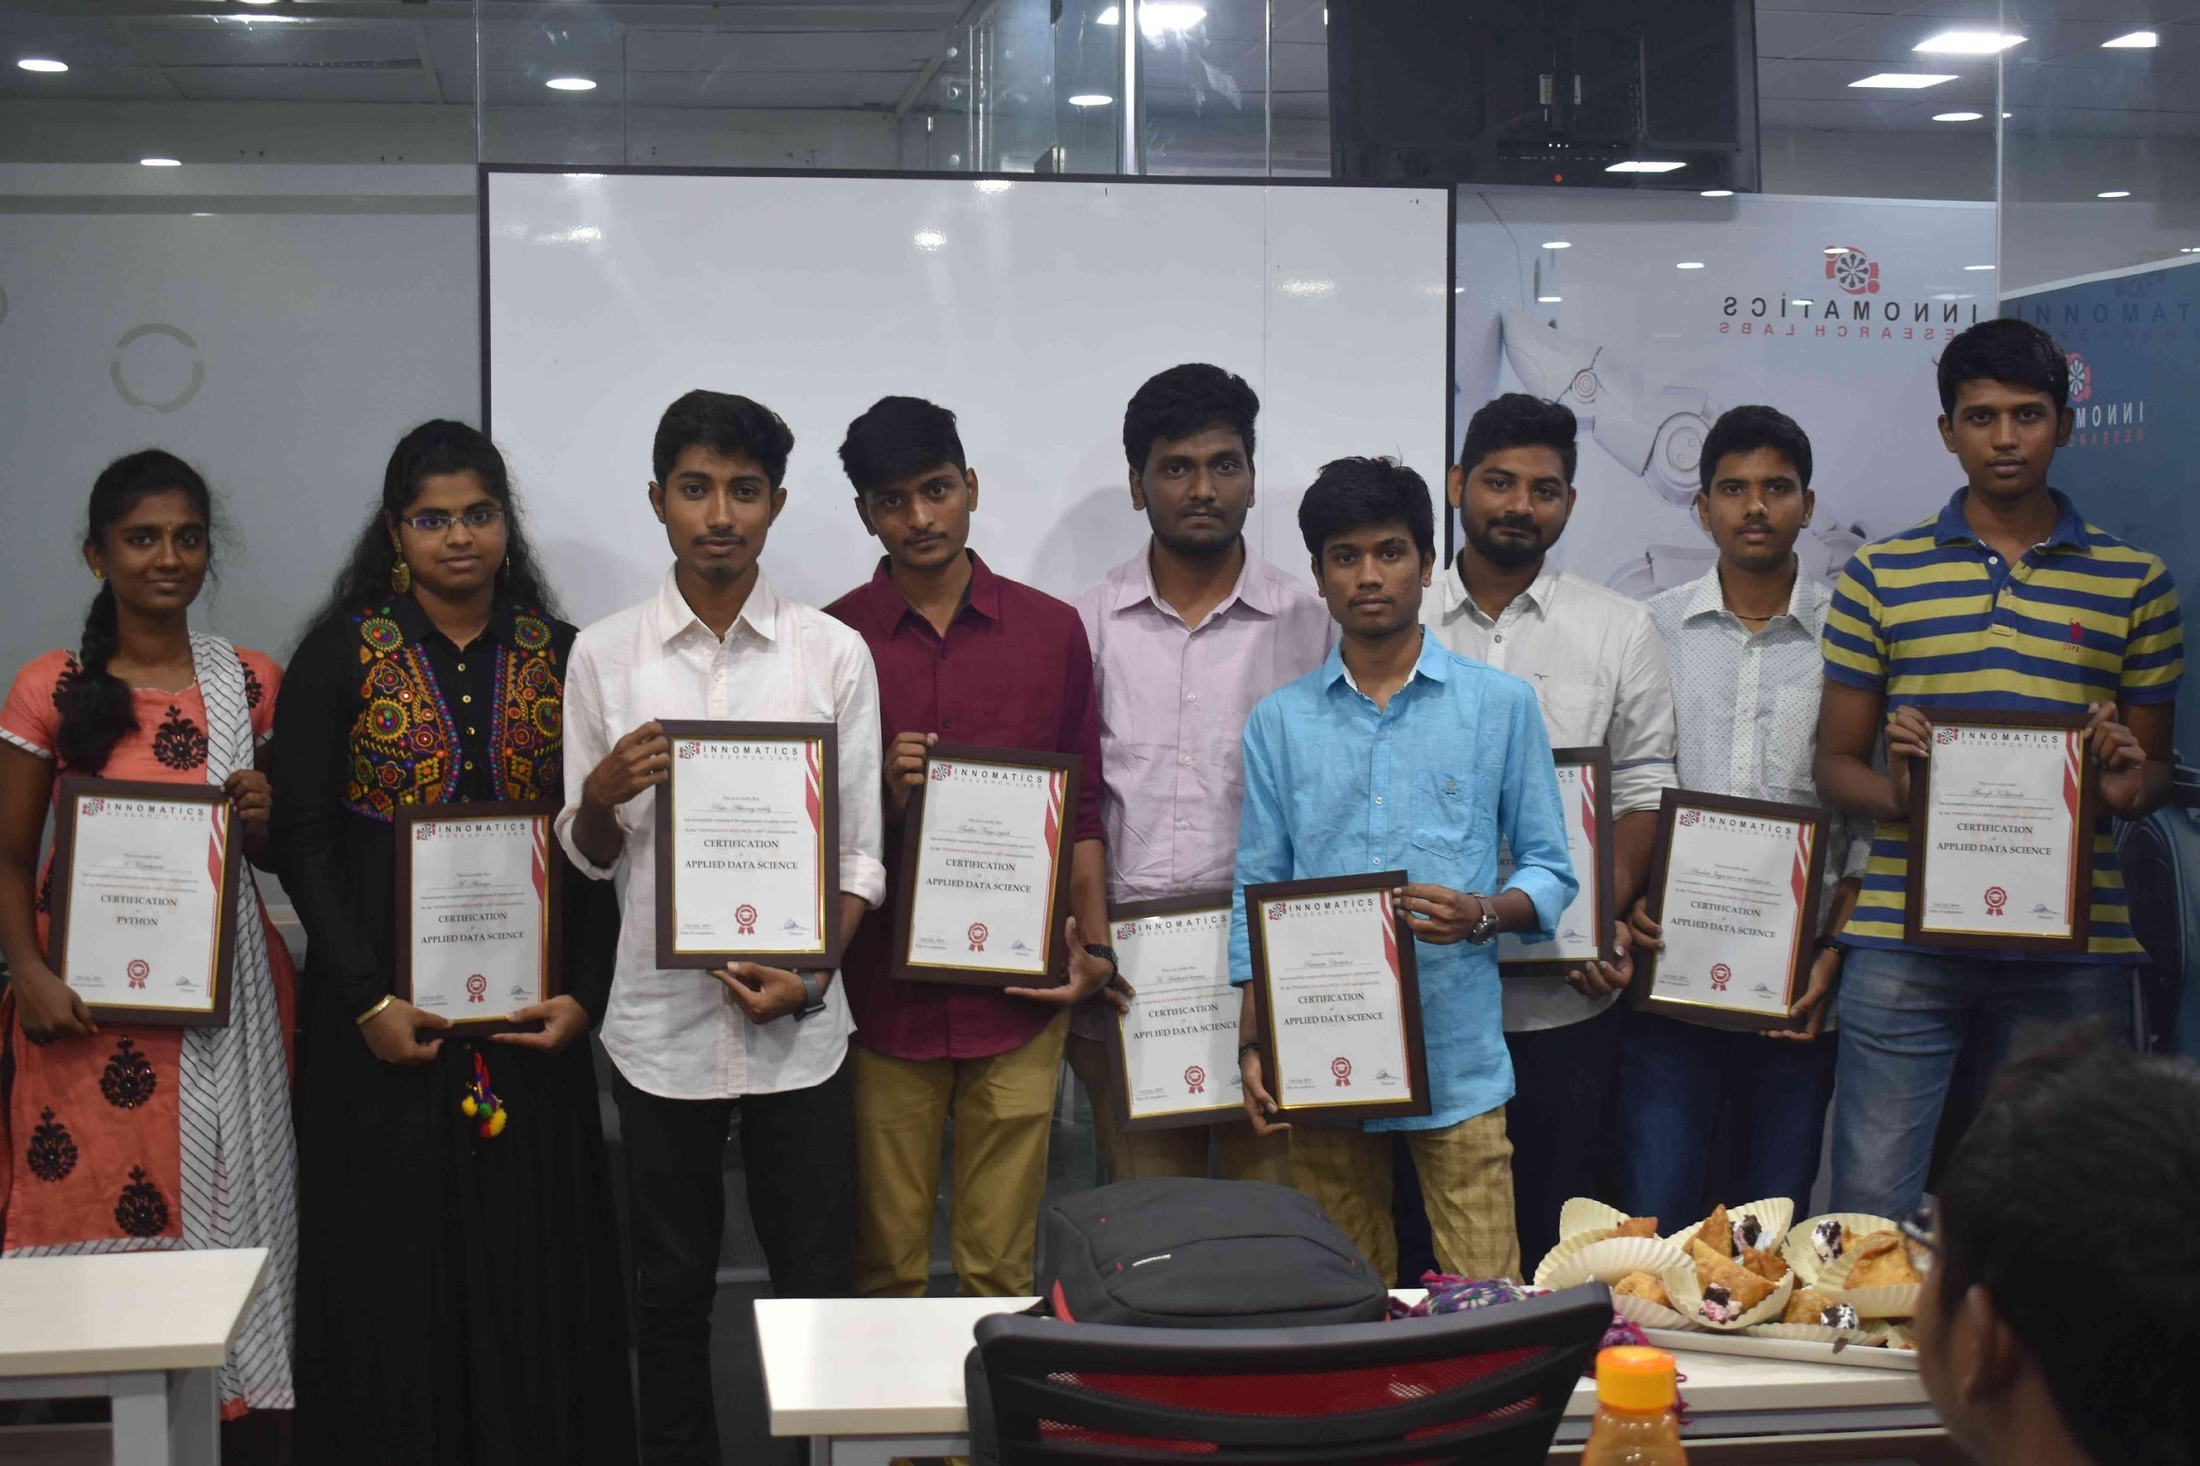
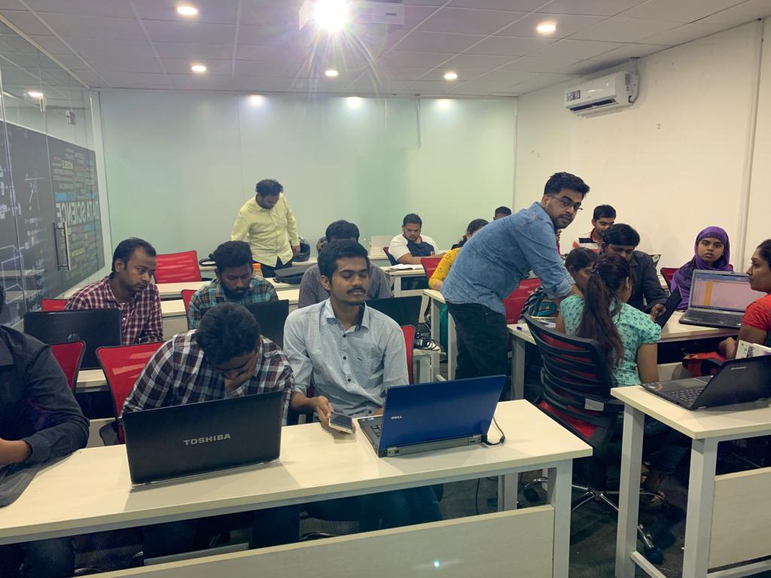

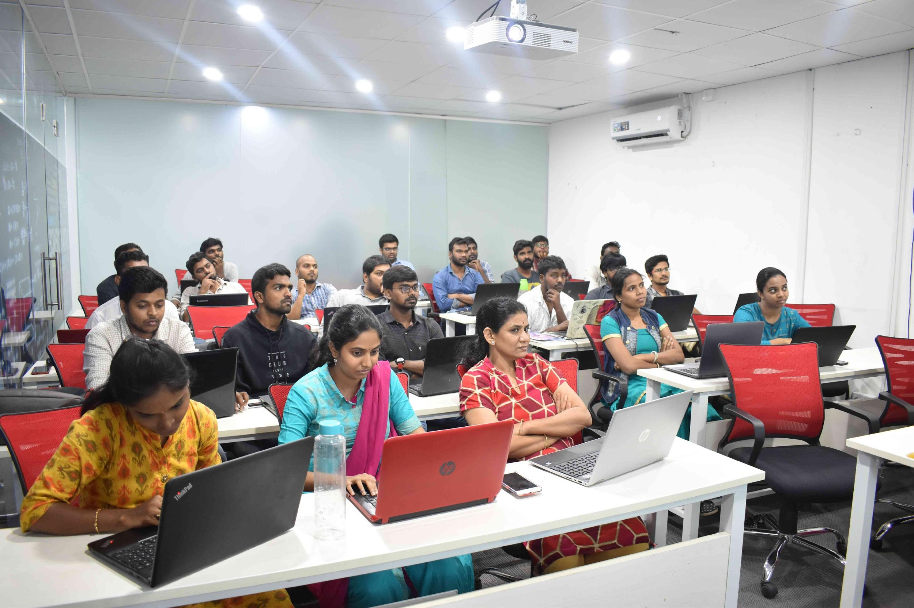
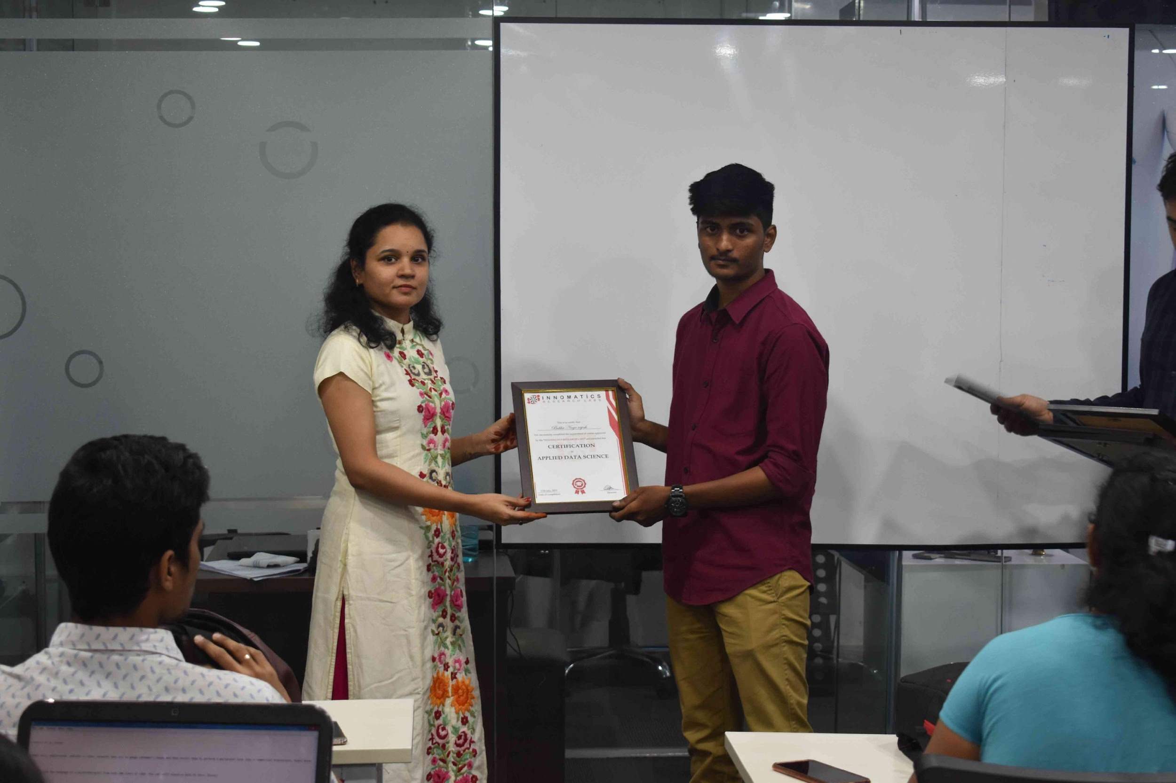
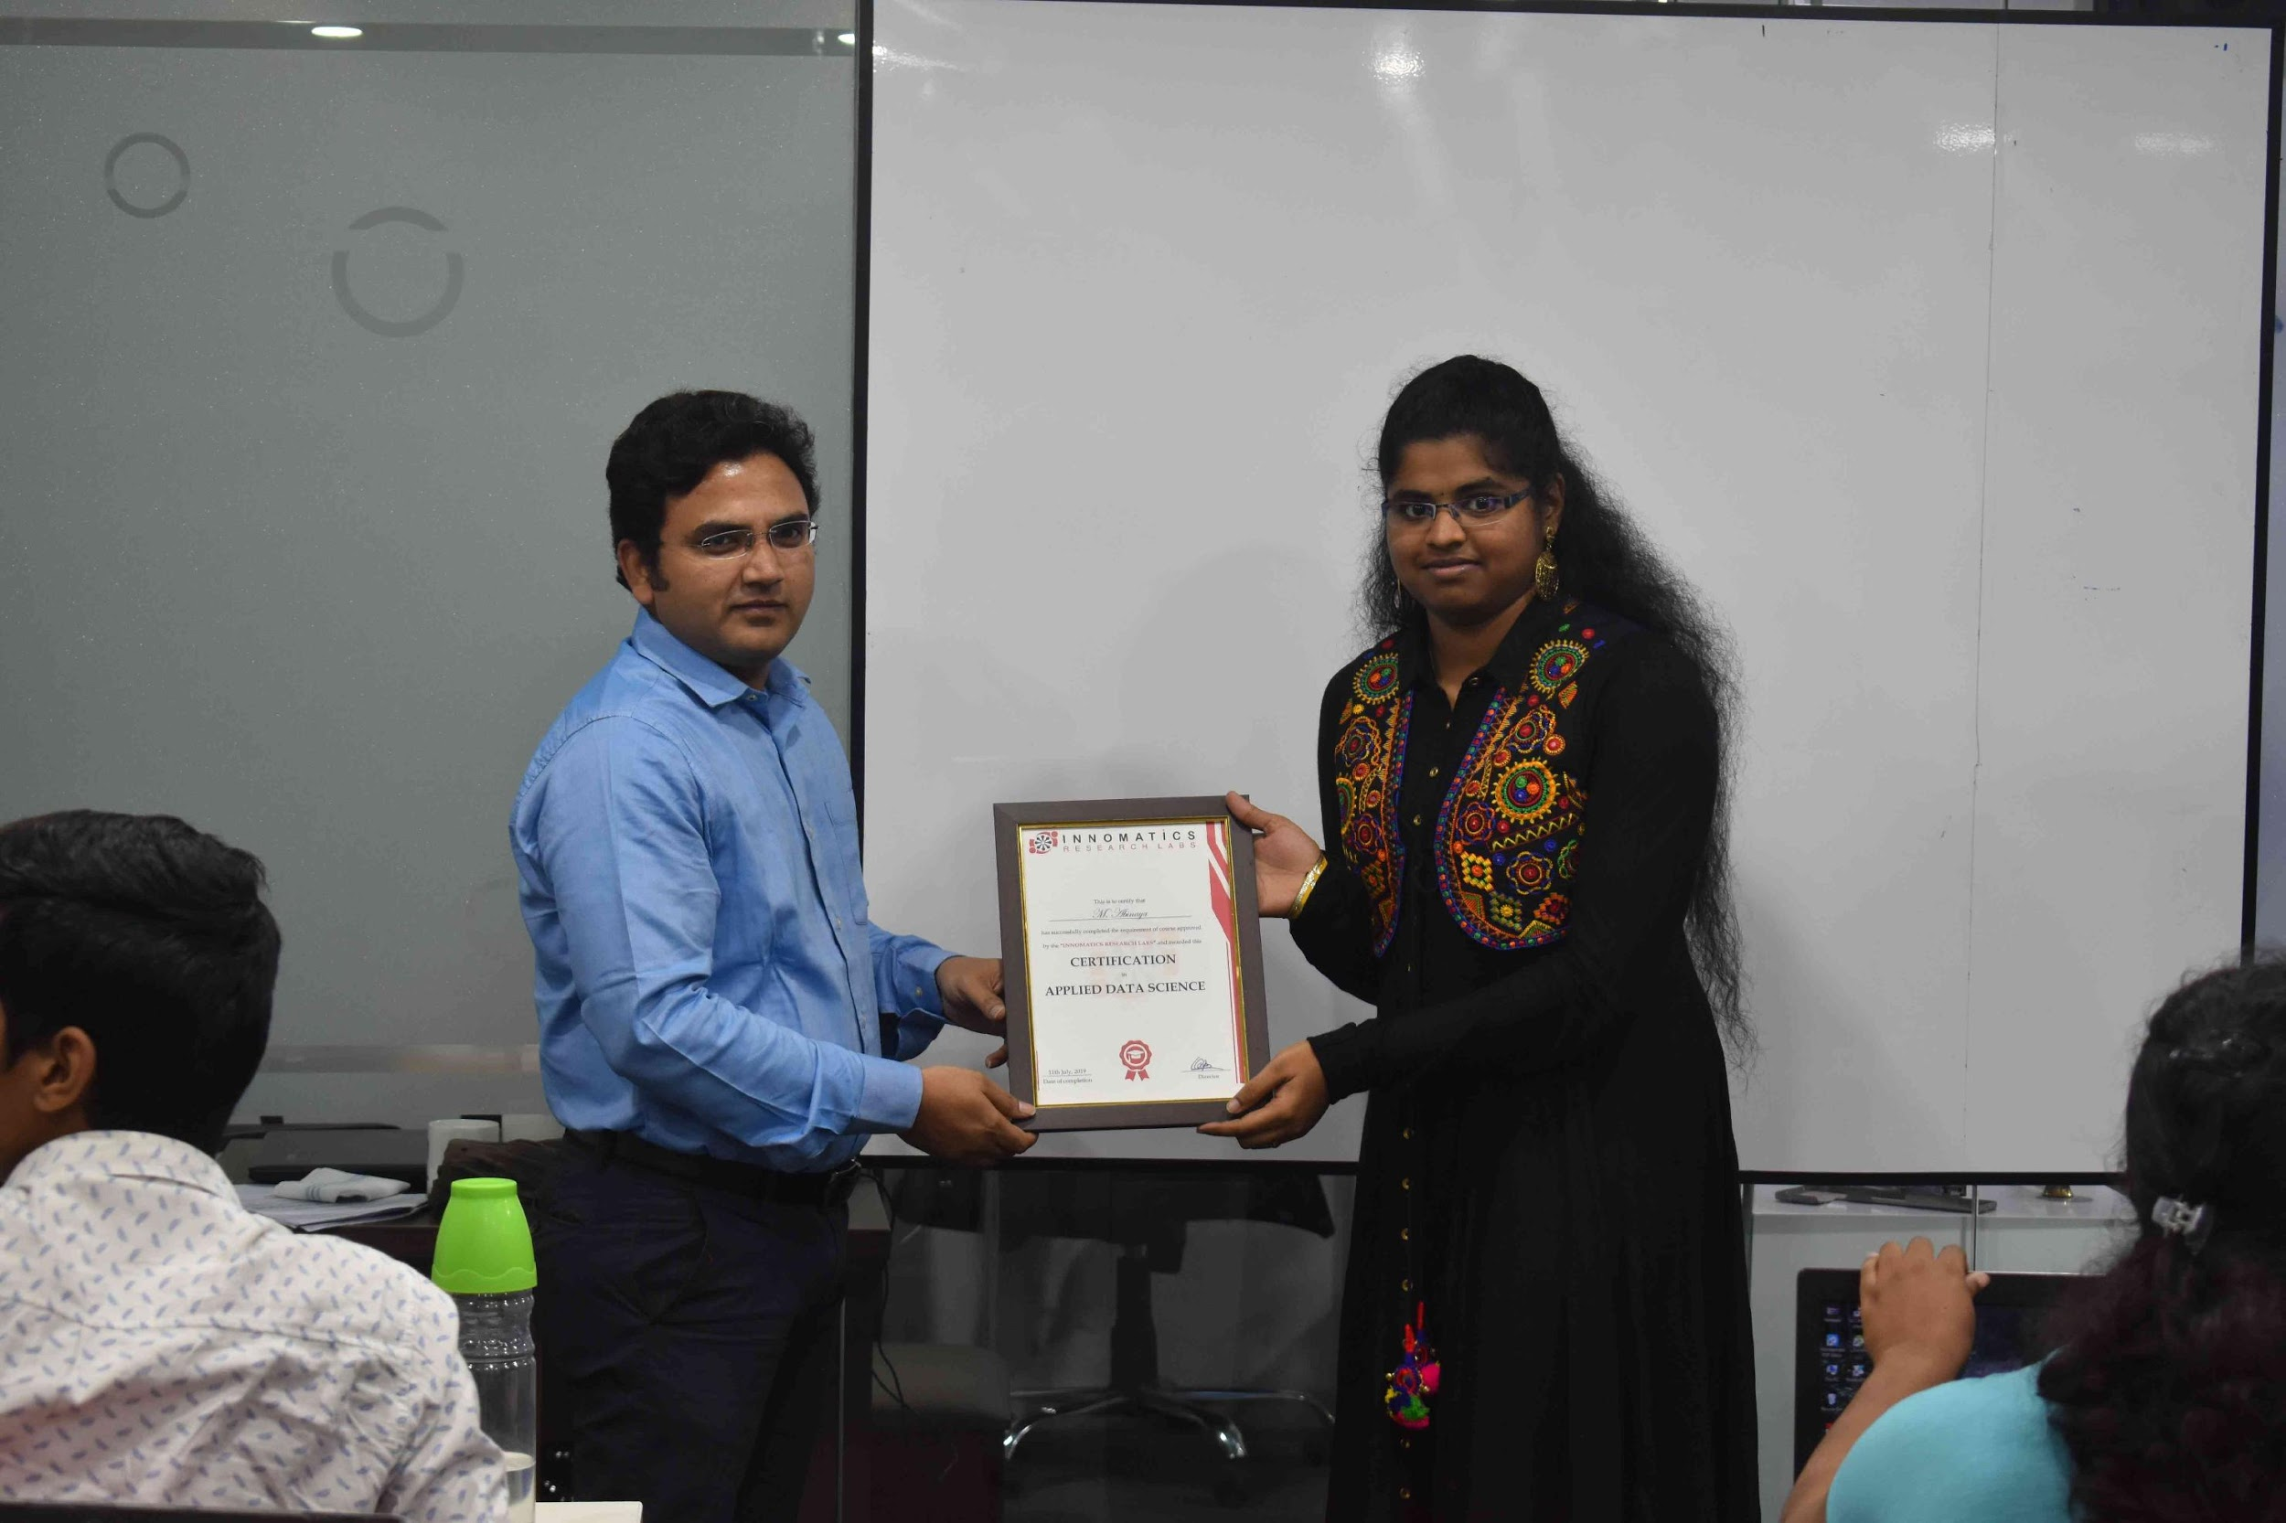

Slide 2
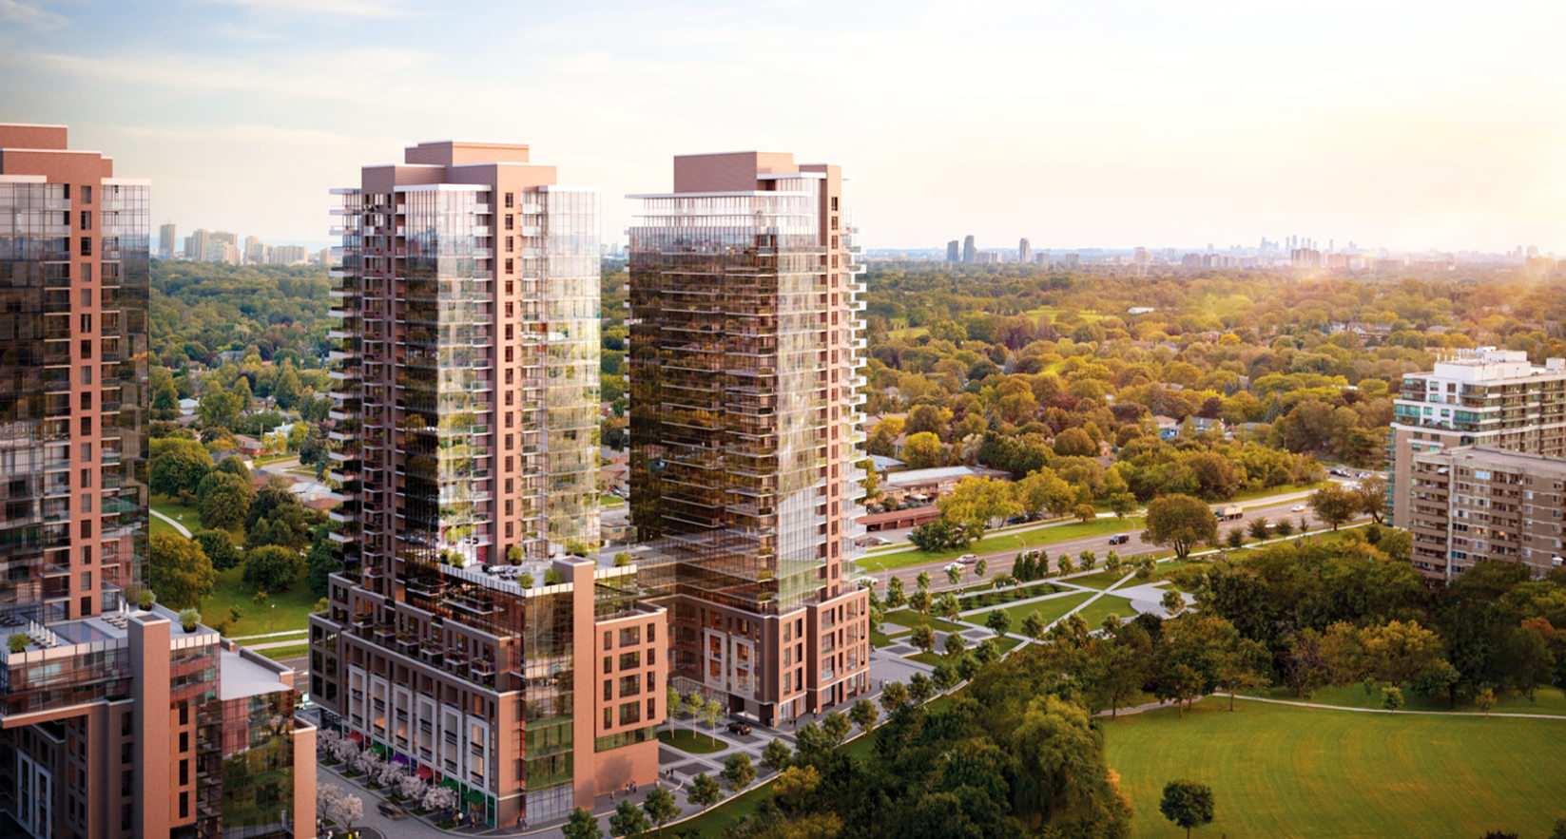

ABOUT ME :
Name : Srivarshith Daladuli B.Sc(Mathematics)
Md Khaja Rahamath B.Tech(Civil Engineering)

Slide 3
What is Web Scraping ?
•
Web scraping is a technique to fetch data from websites. While surfing on the web, many websites don’t allow the user to save data for personal use. One way is to manually copy-paste the data, which both tedious and time-consuming.
•
Web Scraping is the automation of the data extraction process from websites. This event is done with the help of web scraping software known as web scrapers. They automatically load and extract data from the websites based on user requirements. These can be custom built to work for one site or can be configured to work with any website.
•
Some of the main use cases of web scraping include price monitoring, price intelligence, news monitoring, lead generation, and market research among many others.

Slide 4


PROJECT TITLE
WEBSCRAPING AND EXPLORATORY DATA ANALYSIS ON
https://www.makaan.com/

Slide 5
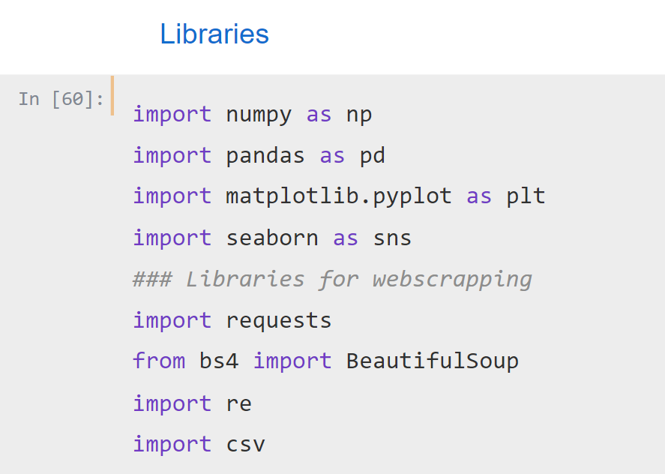
LIBRARIES USED IN THIS PROJECT

Slide 6
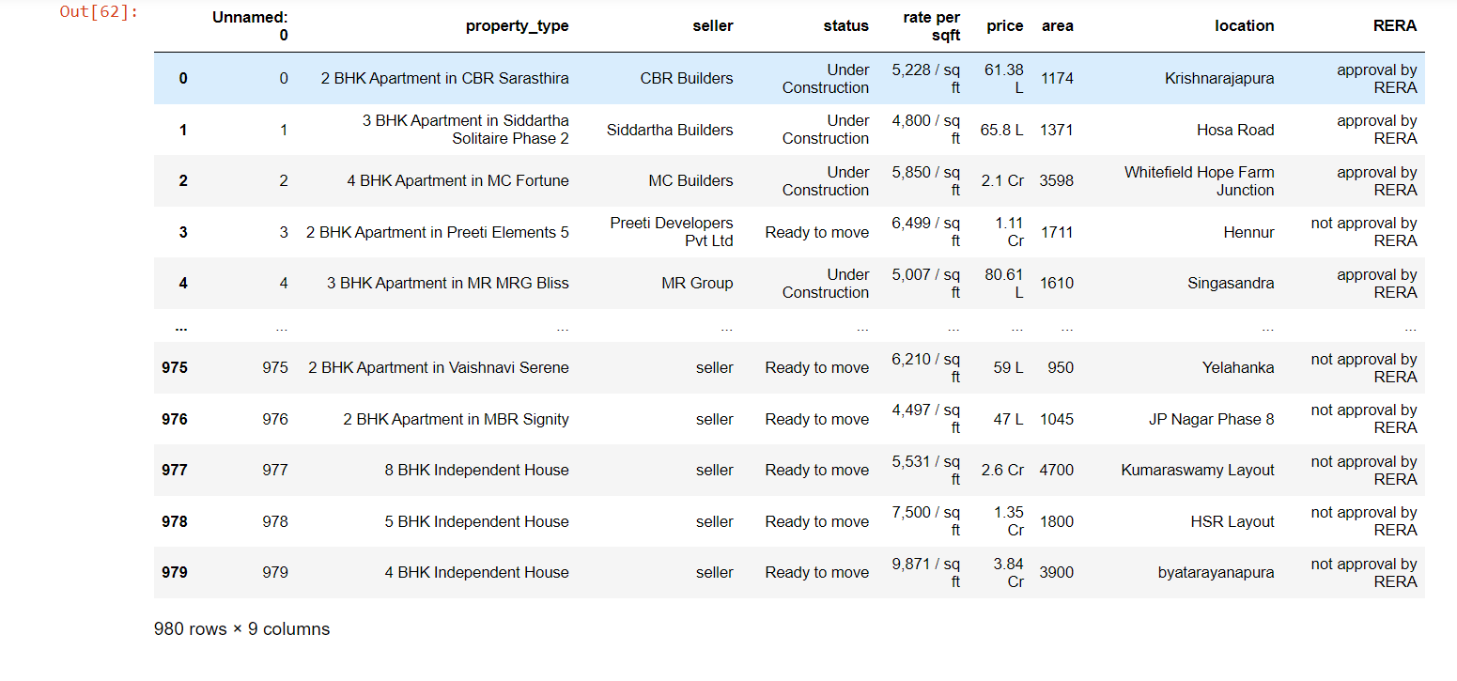
CREATION OF DATAFRAME
We can observe 980 rows and 9 columns

Slide 7
BEFORE CLEANSING THE DATA

Slide 8
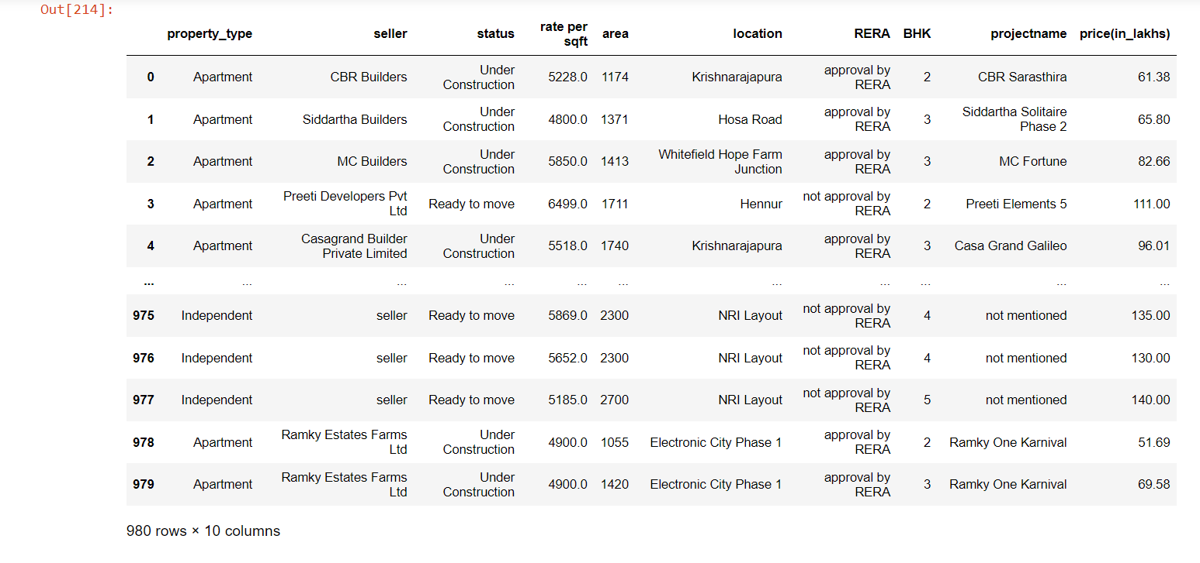
AFTER CLEANSING THE DATA

Slide 9

DATA VISUALIZATION

Slide 10
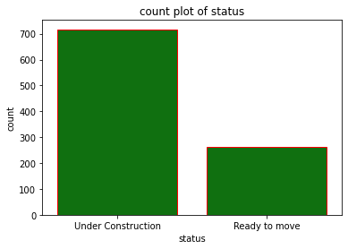
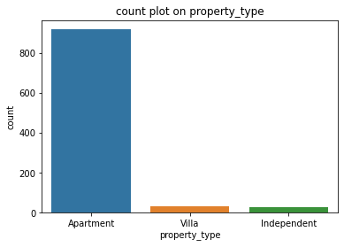
COUNT PLOT
Status :The Under Construction sites are more compared to ready to move
Property Types : The Apartments are more than other property type

Slide 11
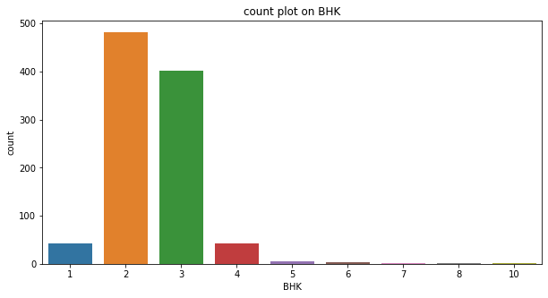
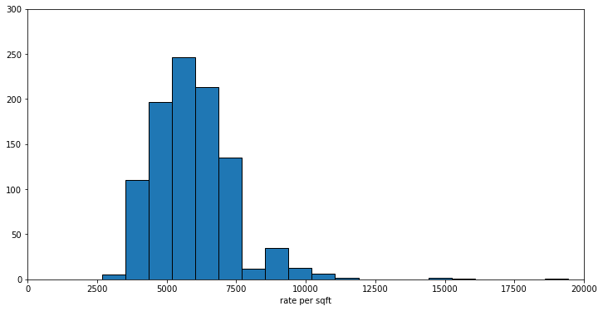
BHK : The 2 BHK are mostly available
Rate per sqft
Observation : Most of the houses have 5500 to 7500 rs/sqft

Slide 12
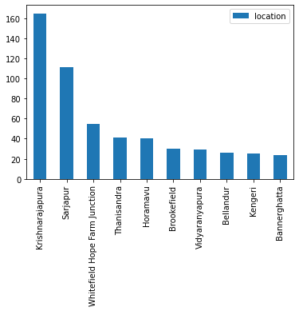
Properties in Location
Observation : Krishnarajapura & Sarjapur has most number of properties

Slide 13
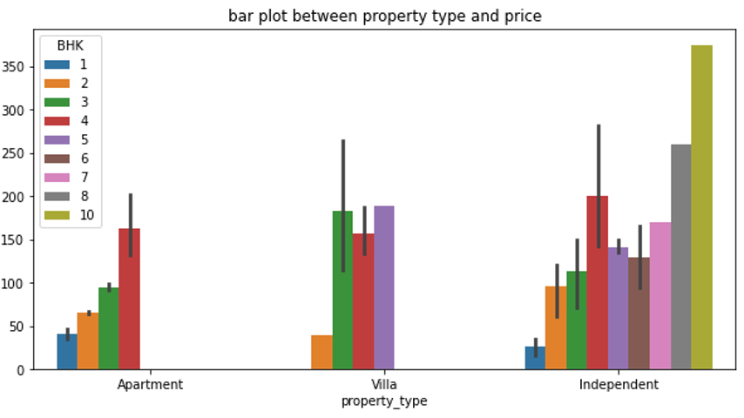
Observation :
below 200 lakhs--- Upto 4 BHK apartment houses,3 BHK Villas,4 BHK Independent houses
Below 350 lakhs ---5,6 BHK apartments,4 BHK villas, 5,7BHK independent houses
Above 350 lakhs---5,6 BHK villas,5 BHK apartments,7,10 BHK independent houses

Slide 14
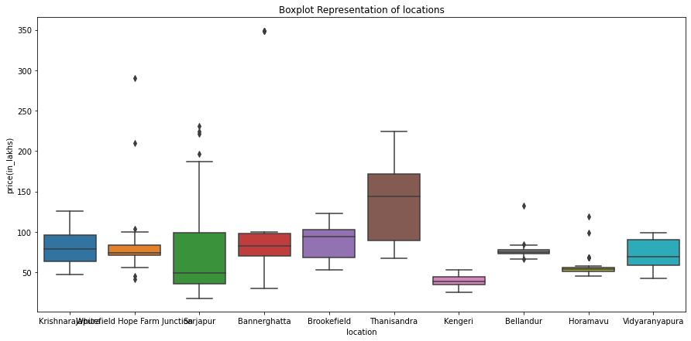
Box plot for Location and Price :
Observation :
In every location 50 lakh to 200 lakhs price houses are available
In Sarjapur, Thanisandra below 350 lakhs price houses are available
Only in Sarjapur above 350 lakh price houses are available

Slide 15
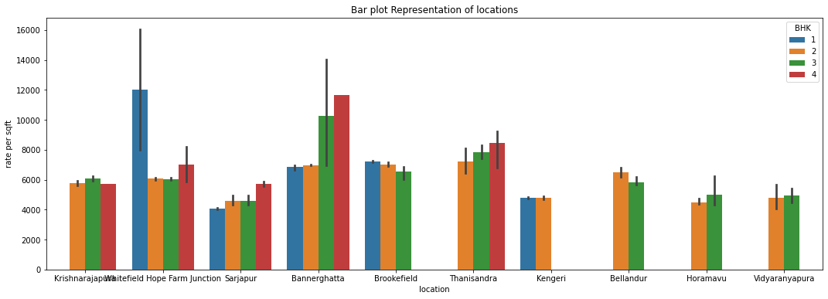
Bar plot b/w Location & Rate per sqft
Observation :
mostly in every location,the rate per sqft is between 6k to 7.5k
In White Field and Bannerghatta,Thanisandra for 4BHK houses the rate per sqft is nearly 10k

Slide 16
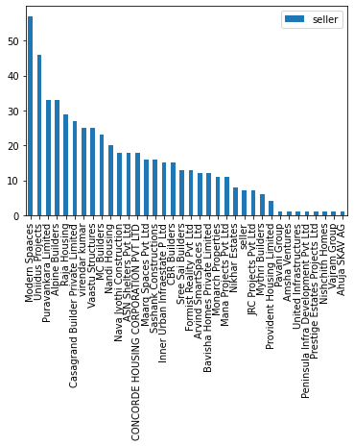
Observation : Modern Spaces and Uniidus Projects selling houses for high cost compared to other sellers .

Slide 17
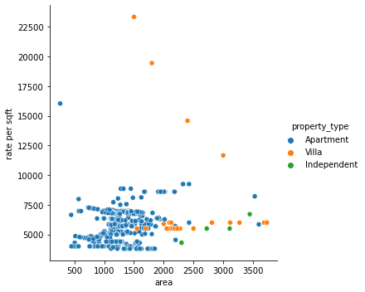
Relation Plot
Observations:
The area and rate per sqft are positively positively correlated for apartments
For Villas and Independent houses less positively correlated

Slide 18
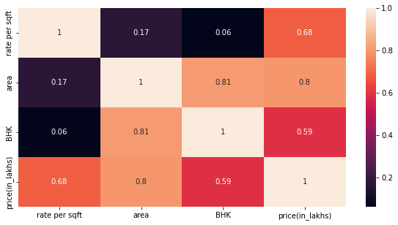
Heat Map
Observations:
BHK and area are highly correlated
Area and rate per sqft are less correlated

Slide 19
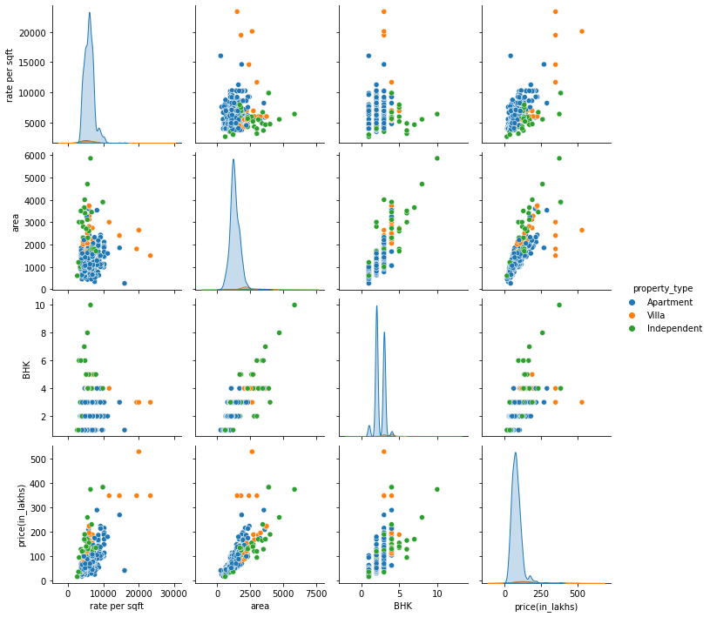
Pair Plot

Slide 20
CONCLUSION :
• We can compare the data with new data periodically ,to know the growth and development of an area ,for future investments or buying a property at developing area at a minimal price.

Slide 21

THANK YOU

Slide 22

Q & A

